Slide 1
VANTAGE
ENTERPRISE OPERATIONS INTELLIGENCE
AI-NATIVE OPERATIONS FOR HEALTHCARE PAYERS
Keep the
enterprise moving.
SEE
One operating picture
UNDERSTAND
Source facts + bounded AI
Claims. Member service. Technology. AI.
Evidence behind the next operating decision.
DECIDE
Named owner + accepted proof
Explore the working product →
VANTAGE / v0.34 / HEALTHCARE PAYER STRATEGY
01
Notes:
Commercial edition v0.34, reflecting implemented product capabilities v0.27–v0.33. No customer traction, revenue, valuation or realized ROI is asserted. VANTAGE is the product name; the initial buyer is a healthcare payer operations leader.

Slide 2
VANTAGE
ENTERPRISE OPERATIONS INTELLIGENCE
THE DECISION PROBLEM
The queue is only the beginning.
A consequential payer decision crosses business work, service delivery, technology and AI.
01
Different systems
Claims inventory, member-service pressure and technical conditions arrive with different clocks and definitions.
02
One accountable owner
The owner needs a supported decision, an inspectable explanation and a clear way to verify what follows.
Presentation context: the hosted product uses synthetic reference data. Customer sources, live inference and effects require activation; customer outcomes remain unproven.
VANTAGE / v0.34 / HEALTHCARE PAYER STRATEGY
02
Notes:
Illustrative buyer problem, not an observed customer incident. The screenshots in this deck are actual built/reference product captures, never the populated fake-provider browser harness. Completed source-reader and inference implementation must be distinguished from customer configuration, actual provider execution and measured commercial outcomes.

Slide 3
VANTAGE
ENTERPRISE OPERATIONS INTELLIGENCE
THE PAYER WEDGE
Protect claims flow.
Keep member service in view.
SEE THE WORK
REVIEW THE EVIDENCE
PROVE THE DECISION
Reported queue pressure
Astra-assisted investigation
A named operating owner
Open inventory, supplied deadline buckets and missing deadlines from one approved aggregate source.
Tentative priorities and evidence questions beside exact, cited snapshot facts.
Connect the review to the customer’s response process and measure the result. This is the next proof gate.
VANTAGE / v0.34 / HEALTHCARE PAYER STRATEGY
03
Notes:
https://github.com/SamSnead85/vantage-ai-native-ops/blob/main/docs/commercial/ADMITTED-CLAIMS-DEADLINE-WATCH.md
https://github.com/SamSnead85/vantage-ai-native-ops/blob/main/docs/activation/GROUNDED-CLAIMS-REASONING.md
Claims counts are source-reported at a snapshot, not current backlog or forecasts. Aggregate validation does not prove cross-queue claim deduplication or SLA compliance. The full payer decision-to-outcome journey remains a customer proof milestone.

Slide 4
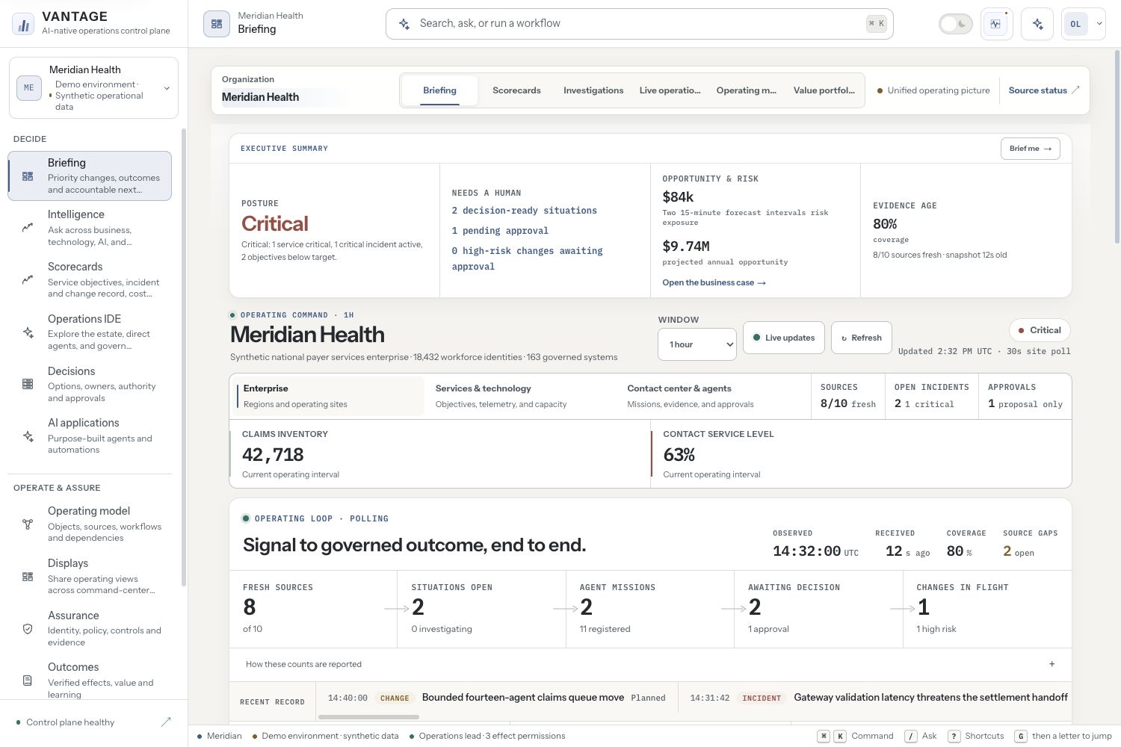
VANTAGE
ENTERPRISE OPERATIONS INTELLIGENCE
THE EXECUTIVE APPLICATION
An operating picture built for the room.
Clear hierarchy.
Evidence first.
One next step.
Warm daylight and graphite workspaces support executive review and operator depth.
Actual reference product · Synthetic operational evidence
VANTAGE / v0.34 / HEALTHCARE PAYER STRATEGY
04
Notes:
Actual built product screenshot supplied by release acceptance. Briefing uses synthetic reference snapshot values. Visible risk and annual-opportunity figures are modeled reference amounts, not realized customer savings or ROI. The presence of an AI-native interface does not establish live provider inference. Capture provenance: https://github.com/SamSnead85/vantage-ai-native-ops/blob/main/docs/commercial/COMMERCIAL-CLAIM-MAP-v0.34.md

Slide 5
VANTAGE
ENTERPRISE OPERATIONS INTELLIGENCE
ONE PLATFORM / FOUR CONNECTED LENSES
Keep the business question in view.
PAYER OPERATIONS
TECHNOLOGY
Claims inventory and deadlines; member-service reference workflows
Registered technical reports, service context and source coverage
AI OVERSIGHT
COORDINATION
Model token usage, reported billing and bounded claims review
Workflow results, durable internal notices and explicit human authority
VANTAGE / v0.34 / HEALTHCARE PAYER STRATEGY
05
Notes:
https://github.com/SamSnead85/vantage-ai-native-ops/blob/main/src/components/intelligence/IntelligenceNavigation.tsx
https://github.com/SamSnead85/vantage-ai-native-ops/blob/main/docs/commercial/ADMITTED-METRIC-INTELLIGENCE.md
https://github.com/SamSnead85/vantage-ai-native-ops/blob/main/docs/activation/DURABLE-COORDINATION.md
These are implemented surfaces and contracts with different activation states. They do not yet join all sources into a single causal model or promise arbitrary natural-language querying across the estate.

Slide 6
VANTAGE
ENTERPRISE OPERATIONS INTELLIGENCE
THE ANSWER CONTRACT
An answer has a source.
An inference has a boundary.
01
Define
Registered question, counting unit, exact window and approved source.
02
Reconcile
Complete queue coverage, explicit zeros, stable evidence identity and current policy.
03
Explain
Exact facts remain source-authored. Model wording, ordering and suggestions remain interpretations.
VANTAGE / v0.34 / HEALTHCARE PAYER STRATEGY
06
Notes:
https://github.com/SamSnead85/vantage-ai-native-ops/blob/main/src/lib/enterprise-intelligence/production-claims.ts
https://github.com/SamSnead85/vantage-ai-native-ops/blob/main/src/lib/grounded-reasoning/contract.ts
https://github.com/SamSnead85/vantage-ai-native-ops/blob/main/src/components/intelligence/reasoning-contract.ts
Unsupported/missing/stale/conflicting evidence causes abstention. No claim of universal enterprise search, forecasts or automatic staffing decisions. A digest is an integrity binding, not an independent signature or proof of policy compliance.

Slide 7
VANTAGE
ENTERPRISE OPERATIONS INTELLIGENCE
ADMITTED EVIDENCE
Four concrete reads.
Precise limits that make them useful.
Operational reports
Registered source and metric definitions
Claims aggregates
Complete roster; snapshot inventory and deadline buckets
OpenTelemetry GenAI
Paired token streams; one complete 15-minute interval
OpenAI reported costs
Closed UTC day; project totals and unattributed amounts
Customer-controlled captures enter existing tenant-bound ingestion. No upstream polling or credentials are implied by these readers.
VANTAGE / v0.34 / HEALTHCARE PAYER STRATEGY
07
Notes:
https://github.com/SamSnead85/vantage-ai-native-ops/blob/main/docs/commercial/ADMITTED-METRIC-INTELLIGENCE.md
https://github.com/SamSnead85/vantage-ai-native-ops/blob/main/docs/commercial/ADMITTED-CLAIMS-DEADLINE-WATCH.md
https://github.com/SamSnead85/vantage-ai-native-ops/blob/main/docs/commercial/ADMITTED-AI-USAGE-LEDGER.md
https://github.com/SamSnead85/vantage-ai-native-ops/blob/main/docs/commercial/ADMITTED-OPENAI-BILLING.md

Slide 8
VANTAGE
ENTERPRISE OPERATIONS INTELLIGENCE
AI OVERSIGHT
Know the usage.
Keep reported cost honest.
USAGE LEDGER
BILLING LEDGER
Who reported the tokens?
What cost was reported?
Provider, service, requested model and response model attribution. Exact input and output sums in the admitted window.
OpenAI’s closed-day project costs, preserved as exact amounts with source scope and reconciliation limits.
Token volume does not establish request count, quality, p95 latency or business value.
Separate from invoices, token-price estimates, model chargeback and cross-provider spend.
VANTAGE / v0.34 / HEALTHCARE PAYER STRATEGY
08
Notes:
https://github.com/SamSnead85/vantage-ai-native-ops/blob/main/docs/commercial/ADMITTED-AI-USAGE-LEDGER.md
https://github.com/SamSnead85/vantage-ai-native-ops/blob/main/docs/commercial/ADMITTED-OPENAI-BILLING.md
The current OTLP profile uses histogram sums as tokens; histogram counts are not request volumes. Provider billing and usage windows are different observations and are not automatically joined. Broader AI quality/ownership/business-outcome attribution remains future source work.

Slide 9
VANTAGE
ENTERPRISE OPERATIONS INTELLIGENCE
GROUNDED ASTRA REVIEW / ACTIVATION REQUIRED
Useful interpretation.
Inspectable limits.
01
Choose the moment
An operator explicitly requests the registered claims review. No automatic paid retry.
02
Constrain the input
Approved aggregate facts and queue aliases; source and processing policy are pinned before dispatch.
03
Check the result
Citations, exact facts, usage and current evidence are validated. Tentative prose stays unverified.
VANTAGE / v0.34 / HEALTHCARE PAYER STRATEGY
09
Notes:
https://github.com/SamSnead85/vantage-ai-native-ops/blob/main/docs/activation/GROUNDED-CLAIMS-REASONING.md
https://github.com/SamSnead85/vantage-ai-native-ops/blob/main/src/lib/grounded-reasoning/openai-responses.ts
Implemented foreground OpenAI Responses integration for gpt-6-astra with45s server and50s browser bounds. Acceptance uses fake provider responses; no live provider/customer inference is asserted. Egress approval, source scope and server credential are required. store:false is not a zero-retention, regional-processing or healthcare-processing guarantee. Interrupted calls may incur charges.

Slide 10
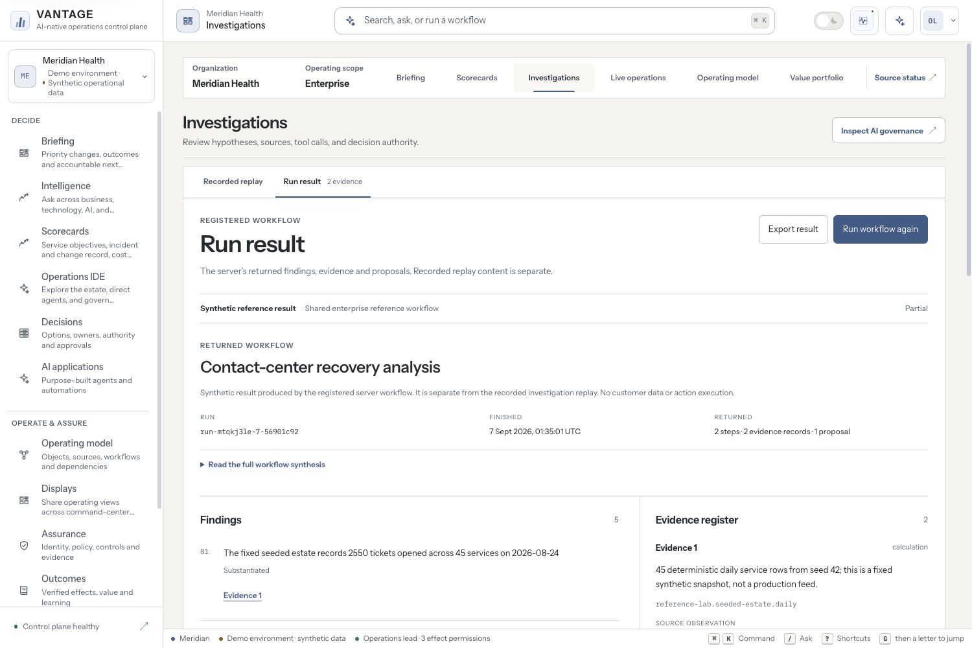
VANTAGE
ENTERPRISE OPERATIONS INTELLIGENCE
WHAT THE WORKFLOW ACTUALLY RETURNED
Keep the result. Inspect its evidence.
Findings
Citations
Gaps
Proposals
A separate result pane preserves the returned workflow identity and evidence.
Actual registered reference result · No customer data or action execution
VANTAGE / v0.34 / HEALTHCARE PAYER STRATEGY
10
Notes:
https://github.com/SamSnead85/vantage-ai-native-ops/blob/main/src/components/executive-command/investigation-workbench/registered-investigation-run.ts
https://github.com/SamSnead85/vantage-ai-native-ops/blob/main/docs/commercial/PRODUCTION-RELEASE-PASSPORT-v0.32.0.md
The pictured result is produced by the registered server reference workflow, not model inference. Durable production status can be resumed without resubmitting the original task. Replay hypotheses and modeled economics are not copied into returned results.

Slide 11
VANTAGE
ENTERPRISE OPERATIONS INTELLIGENCE
COORDINATED SPECIALIST WORK
Context that survives interruption.
Authority that never comes from a message.
NOTICE
ACKNOWLEDGE
RECOVER
EXPIRE
Service, peer and evidence
Current recipient policy
Lease + exact retry identity
Recheck source and time
Planned-change context preserves the raw alert. Security remains a specialist concern.
VANTAGE / v0.34 / HEALTHCARE PAYER STRATEGY
11
Notes:
https://github.com/SamSnead85/vantage-ai-native-ops/blob/main/src/lib/agent-coordination/durable-service.ts
https://github.com/SamSnead85/vantage-ai-native-ops/blob/main/scripts/run-coordination-worker.mjs
PostgreSQL-backed internal acknowledgements, worker supervision, current admission, tenant/peer validation, expiry and lost-response recovery are implemented and tested, including disposable PostgreSQL acceptance. Customer worker/source/peer activation is still required. No alert suppression, authority upgrade or external SOC delivery is claimed. Agent communication is an established market capability, not unique to VANTAGE.

Slide 12
VANTAGE
ENTERPRISE OPERATIONS INTELLIGENCE
AN OPERATING CENTER, ACROSS SCREENS
One estate.
Four shareable display views.
EXECUTIVE OPERATIONS
SERVICE HEALTH
Commitments, incidents and decisions
Registered services and objectives
CAPACITY AND COST
AGENT OPERATIONS
Utilization and modeled opportunities
Specialists, missions and human review
VANTAGE / v0.34 / HEALTHCARE PAYER STRATEGY
12
Notes:
https://github.com/SamSnead85/vantage-ai-native-ops/blob/main/src/lib/operations-displays/projection.ts
https://github.com/SamSnead85/vantage-ai-native-ops/blob/main/docs/commercial/PRODUCTION-RELEASE-PASSPORT-v0.27.0.md
Shareable monitor views are based on the registered reference snapshot, not a customer-connected telemetry wall. Display descriptions must match the actual route/profile names. Durable agent/runtime activity and synthetic reference agents remain distinct.

Slide 13
VANTAGE
ENTERPRISE OPERATIONS INTELLIGENCE
OPERATIONS + SECURITY
Share the context.
Preserve specialist response authority.
VANTAGE OPERATING PICTURE
EXISTING SECURITY STACK
Business consequence
Detection and response
Connect the affected work, source evidence, owner and coordination context across operations.
Keep SIEM/XDR analytics, security retention, containment and specialist approvals with their systems of record.
VANTAGE / v0.34 / HEALTHCARE PAYER STRATEGY
13
Notes:
Recommendation: federate operations and security, not replace the SIEM/XDR stack. A shared team can use common context while retaining separate authorization and response controls. External SOC connectors require explicit implementation and customer acceptance. Competitive grounding: https://github.com/SamSnead85/vantage-ai-native-ops/blob/main/docs/commercial/COMPETITIVE-LANDSCAPE-2026.md

Slide 14
VANTAGE
ENTERPRISE OPERATIONS INTELLIGENCE
WHY THIS CAN BECOME VALUABLE
Payer meaning. Repeatable activation.
Accepted operating proof.
01
A consequential wedge
Claims flow and member-service resilience create a specific buyer and an accountable operating problem.
02
Product reuse
Source contracts, evidence definitions and review methods can reduce the next deployment’s bespoke work.
03
Proof that compounds
Customer-accepted results and repeatable delivery can earn expansion. They remain the next evidence to build.
VANTAGE / v0.34 / HEALTHCARE PAYER STRATEGY
14
Notes:
Differentiation hypothesis, not an established moat. DXC OASIS, ServiceNow and Splunk/Cisco already position agents, enterprise context and operations convergence. VANTAGE does not claim unique agent communication, unrestricted visibility, superior measured performance or customer traction. Primary sources reviewed September6,2026: https://dxc.com/platforms/dxc-oasis ; https://www.servicenow.com/products/ai-control-tower.html ; https://www.splunk.com/en_us/blog/leadership/splunk-cisco-live-agentic-operations.html

Slide 15
VANTAGE
ENTERPRISE OPERATIONS INTELLIGENCE
THE DESIGN-PARTNER SCORECARD
Measure improved work.
Count the value once.
Decision effort
Time to a supported review; human rework
Service performance
Reported pressure; recovery and repeat contacts
Cost to serve
Integration, platform, AI and ongoing operating effort
Repeatability
Activation effort and reusable product share
VANTAGE / v0.34 / HEALTHCARE PAYER STRATEGY
15
Notes:
https://github.com/SamSnead85/vantage-ai-native-ops/blob/main/docs/commercial/DESIGN-PARTNER-MEASUREMENT-PROTOCOL.md
Agree baseline, matched measurement window, counterfactual, attribution, owner acceptance and reliability guardrails. Convert effort to money only using accepted rates, subtract incremental costs and avoid double-counting overlapping benefits. No VANTAGE ROI, savings, revenue or market-size number is asserted.

Slide 16
VANTAGE
ENTERPRISE OPERATIONS INTELLIGENCE
PROPOSED COMMERCIAL MODEL
Land with one valuable workflow.
Expand through reusable operating packs.
DESIGN PARTNER
ANNUAL PLATFORM
EXPANSION
Paid, bounded proof
License operating value
Reuse before adding breadth
One payer workflow, an approved source set and a joint acceptance scorecard.
Core platform, accepted operating scope and support. Report AI consumption transparently.
Extend into adjacent payer workflows when integration reuse and customer value justify it.
VANTAGE / v0.34 / HEALTHCARE PAYER STRATEGY
16
Notes:
Proposed packaging, not booked revenue, published list pricing or validated demand. Test willingness to pay, gross margin, services share, support effort, paid conversion and expansion. Do not price solely by the number of agents. Enrollment, payer payments, broader workforce data and process discovery remain additional source/capability work.

Slide 17
VANTAGE
ENTERPRISE OPERATIONS INTELLIGENCE
WHERE THE NEXT INVESTMENT GOES
Turn implemented depth
into customer proof.
01
Activate
Identity, approved source captures, customer reconciliation and explicit processing policy.
02
Accept
A named human decision, approved response integration and operational recovery evidence.
03
Expand
A measured outcome, sustainable cost to serve and lower effort on the next deployment.
VANTAGE / v0.34 / HEALTHCARE PAYER STRATEGY
17
Notes:
https://github.com/SamSnead85/vantage-ai-native-ops/blob/main/docs/commercial/PRODUCTION-RELEASE-PASSPORT-v0.33.0.md
https://github.com/SamSnead85/vantage-ai-native-ops/blob/main/docs/activation/GROUNDED-CLAIMS-REASONING.md
Signed release images, tenant isolation, current source policies, durable workers and test evidence are product foundations. Customer security/procurement approval, actual load, restore/failover, source reconciliation, live model evaluation and approved effect adapters still need target-site evidence. No certification or autonomous-enterprise reliability claim.

Slide 18
VANTAGE
ENTERPRISE OPERATIONS INTELLIGENCE
THE NEXT OPERATING MODEL
Bring one consequential
payer workflow.
Make its evidence, decisions
and value inspectable.
Explore VANTAGE →
Product evidence and deployment planning →
VANTAGE / v0.34 / HEALTHCARE PAYER STRATEGY
18
Notes:
Ask for a payer workflow owner, platform owner and assurance counterpart. Agree source availability, success criteria and the first decision to improve. Demonstrate /demo then /command#investigations actual Run result; inspect /intelligence?view=claims, ai, billing and sources activation boundaries; show /displays, /control-plane and /proof. Editable deck generated by scripts/generate-investor-deck.mjs. No commitment to an unverified production date or financial outcome.

